Slide 1

Computer Organization And Architecture
CSE-209
Lecture - 03
Al Bashir
Lecturer, Dept. of CSE
Dhaka International University

Slide 2
Content
Clock Speed

Slide 3
The System Clock
Operations performed by a processor, such as fetching an instruction, decoding the instruction, performing an arithmetic operation, and so on, are governed by a system clock. Typically, all operations begin with the pulse of the clock.
Thus, at the most fundamental level, the speed of a processor is dictated by the pulse frequency produced by the clock, measured in cycles per second, or Hertz (Hz).

Slide 4
The System Clock
Typically, clock signals are generated by a quartz crystal, which generates a constant signal wave while power is applied.
This wave is converted into a digital voltage pulse stream that is provided in a constant flow to the processor circuitry.

Slide 5
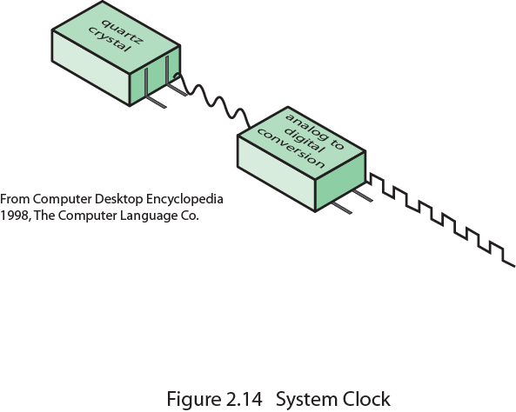
System Clock

Slide 6
The System Clock
For example, a 1-GHz processor receives 1 billion pulses per second. The rate of pulses is known as the clock rate, or clock speed.
One increment, or pulse, of the clock is referred to as a clock cycle, or a clock tick. The time between pulses is the cycle time.

Slide 7
The System Clock
When a signal is placed on a line inside the processor, it takes some finite amount of time for the voltage levels to settle down so that an accurate value (1 or 0) is available.
Furthermore, depending on the physical layout of the processor circuits, some signals may change more rapidly than others.
Thus, operations must be synchronized and paced so that the proper electrical signal (voltage) values are available for each operation.

Slide 8
Performance Assessment: Clock Speed
Key parameters
Performance, cost, size, security, reliability, power consumption
System clock speed
In Hz or multiples of
Clock rate, clock cycle, clock tick, cycle time
Signals in CPU take time to settle down to 1 or 0
Signals may change at different speeds
Operations need to be synchronised
Instruction execution in discrete steps
Fetch, decode, load and store, arithmetic or logical
Usually require multiple clock cycles per instruction
Pipelining gives simultaneous execution of instructions
So, clock speed is not the whole story

Slide 9
Instruction Execution Rate
processor is driven by a clock with a constant frequency f or, equivalently, a constant cycle time Շ = 1/f.
Define the instruction count, Ic, for a program as the number of machine instructions executed for that program until it runs to completion or for some defined time interval.

Slide 10
Instruction Execution Rate
An important parameter is the average cycles per instruction CPI for a program. If all instructions required the same number of clock cycles, then CPI would be a constant value for a processor.
However, on any give processor, the number of clock cycles required varies for different types of instructions, such as load, store, branch, and so on.

Slide 11
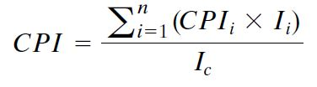
Instruction Execution Rate
Let CPIi be the number of cycles required for instruction type i. and Ii be the number of executed instructions of type i for a given program. Then we can calculate an overall CPI as follows:

Slide 12
Instruction Execution Rate
The processor time T needed to execute a given program can be expressed as-
T = Ic x CPI x Շ
We can refine this formulation by recognizing that during the execution of an instruction, part of the work is done by the processor, and part of the time a word is being transferred to or from memory.

Slide 13
Instruction Execution Rate
In this latter case, the time to transfer depends on the memory cycle time, which may be greater than the processor cycle time.
We can rewrite the preceding equation as:
T = Ic x [p + (m x k)] x Շ
where p is the number of processor cycles needed to decode and execute the instruction, m is the number of memory references needed, and k is the ratio between memory cycle time and processor cycle time.

Slide 14
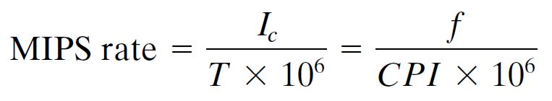
Millions of instructions per second(MIPS)
A common measure of performance for a processor is the rate at which instructions are executed, expressed as millions of instructions per second (MIPS), referred to as the MIPS rate.
We can express the MIPS rate in terms of the clock rate and CPI as follows:

Slide 15
MIPS
For example, consider the execution of a program which results in the execution of 2 million instructions on a 400-MHz processor. The program consists of four major types of instructions. The instruction mix and the CPI for each instruction type are given below based on the result of a program trace experiment:

Slide 16
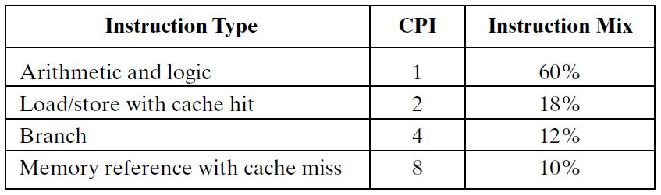
MIPS
The average CPI when the program is executed on a uniprocessor with the above trace results is
CPI = 0.6 + (2 x 0.18) + (4 X 0.12) + (8 X 0.1) = 2.24.
The corresponding MIPS rate is
(400 x 10^6)/(2.24 x 10^6) = 178.

Slide 17
Amdahl’s Law
Gene Amdahl [AMDA67]
Potential speed up of program using multiple processors
Concluded that:
Code needs to be parallelizable
Speed up is bound, giving diminishing returns for more processors
Task dependent
Servers gain by maintaining multiple connections on multiple processors
Databases can be split into parallel tasks

Slide 18
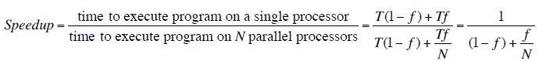
Amdahl’s Law Formula
For program running on single processor
Fraction f of code infinitely parallelizable with no scheduling overhead
Fraction (1-f) of code inherently serial
T is total execution time for program on single processor
N is number of processors that fully exploit parralle portions of code

Slide 19
Conclusions
f small, parallel processors has little effect
N ->∞, speedup bound by 1/(1 – f)
Diminishing returns for using more processors

Slide 20
Question??

Slide 21
Thanks

